Slide 1
SOLID Principles
Single Responsibility Principle
A class should have only one reason to change. Eg Employee class is responsible for storing employee data and calculating salary. If you want to change how salary is calculated, you might have to modify the class. But in doing so, you risk breaking the code that handles data storage or report formatting.
Open & Close Principle
Software entities (classes, modules, functions, etc.) should be open for extension, but closed for modification. Suppose you have a Invoice class that calculates total amount of invoice. And you want to add a discount feature. If you modify that method to handle discount, then you are violating OCP. We can use specification or strategy pattern to solve this.
Liskov substitution Principle
Objects of a superclass should be replaceable with objects of a subclass without affecting the correctness of the program. Try considering virtual and override.
Interface segregation Principle
Clients should not be forced to depend on interfaces they do not use. Meaning create smaller interface than large one.
Dependency Inversion principle
High-level modules should not depend on low-level modules. Both should depend on abstractions (e.g., interfaces or abstract classes). We can consider IOC/DI.

Slide 2
Creational Patterns
Factory Method: The factory method takes in some parameters, which it uses to decide which subclass or implementation of an interface to instantiate.
Abstract Factory: Creates families of related objects without specifying their concrete classes.
Builder: Constructs complex objects step by step, allowing for different representations.
Prototype: Creates new objects by copying existing ones.
Singleton: Ensures a class has only one instance and provides a global access point to it.

Slide 3
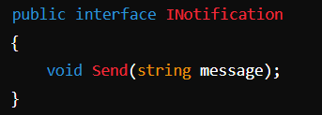
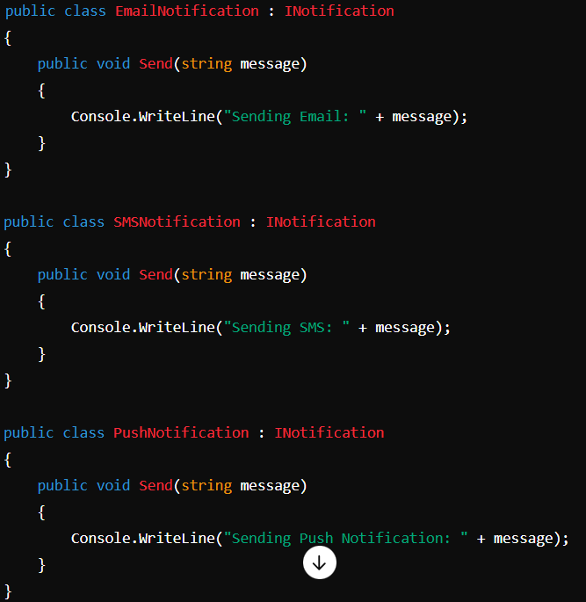
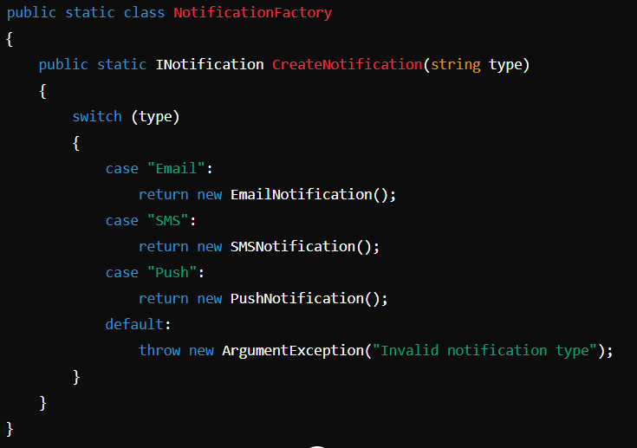
How Does It Work?
In the Factory Pattern, you create a factory class that has a method (often called Create or GetInstance) responsible for creating instances of a particular type. The factory method takes in some parameters, which it uses to decide which subclass or implementation of an interface to instantiate.
Benefits of the Factory Pattern
Encapsulation: The Factory Pattern encapsulates the instantiation logic, making it easier to manage and change the creation process.
Loose Coupling: Clients are decoupled from the specific classes they use, depending only on abstract types (e.g., interfaces or abstract classes).
Scalability: Adding new types of notifications requires minimal changes to the client code. You only need to modify the factory class.
Code Reusability: The factory can be reused across the application wherever object creation is needed.
Factory Method

Slide 4
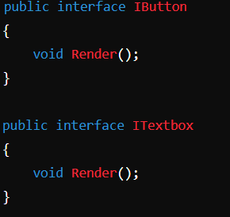
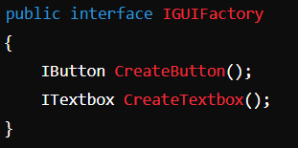
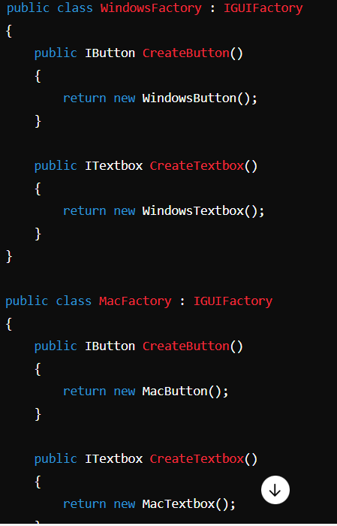
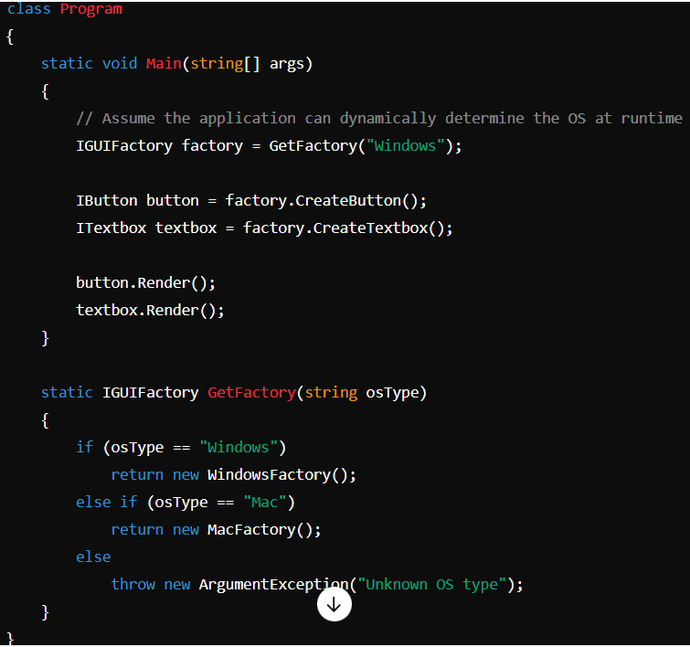
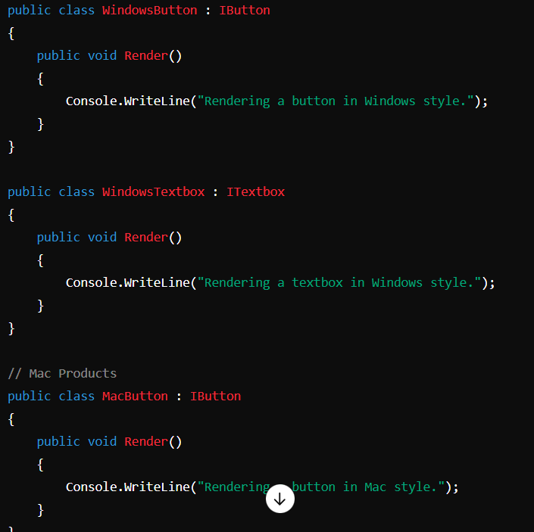
Benefits of the Abstract Factory Pattern
Ensures Consistency: The pattern ensures that products that are created together are compatible with each other, maintaining consistency across families of products.
Encapsulation of Object Creation: The client code is decoupled from the concrete classes of the products it works with. It only knows about the abstract interfaces.
Scalability: Adding a new family of products requires minimal changes to the existing code. You just need to add new product classes and a new factory class.
Flexibility: The pattern allows for the easy exchange of product families at runtime by switching the factory implementation.
How Does It Work?
In an Abstract Factory Pattern, a client interacts with the factory interface to create families of related products. The client does not need to know which specific class is instantiated, as it only interacts with the abstract interfaces provided by the factory.
Abstract Factory

Slide 5
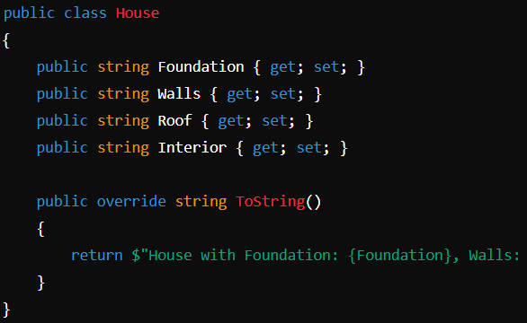
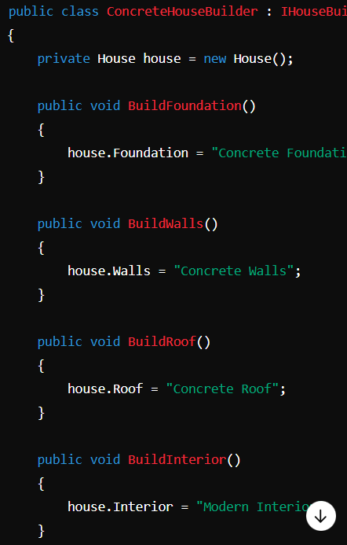
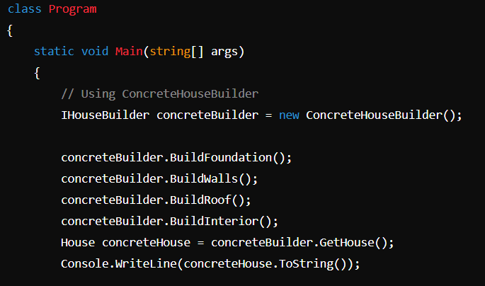
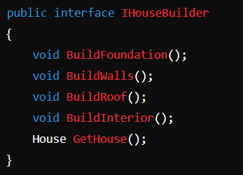
How Does It Work?
The Builder Pattern is a creational design pattern used to construct complex objects step by step. Unlike other creational patterns, which construct objects in a single step, the Builder Pattern allows for the gradual construction of an object, providing more control over the creation process, especially when the object has multiple parts or configurations.
Benefits of the Builder Pattern
Separation of Concerns: The pattern separates the construction of a complex object from its representation, allowing different ways to build an object.
Better Control: Provides finer control over the construction process by allowing the construction to proceed step by step.
Reusability: Builders can be reused across different parts of the system to create objects with a similar construction process.
Immutable Objects: When constructing immutable objects, the Builder Pattern is beneficial because it allows for setting all properties before the object is created.
Builder

Slide 6
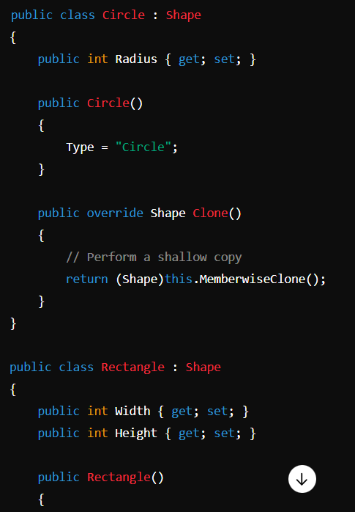
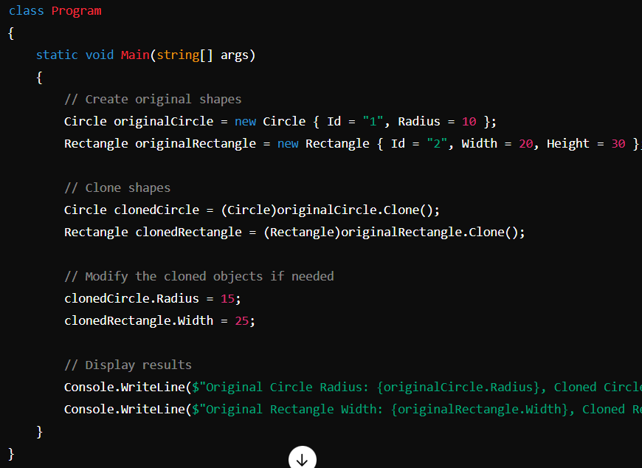
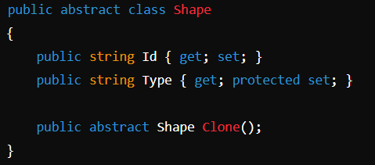
How Does It Work?
The Prototype Pattern is a creational design pattern used to create new objects by copying an existing object, known as the prototype. This pattern is particularly useful when the process of creating an object is costly or complex, and you want to avoid. Instead, you clone an existing object and then make modifications as needed.
Benefits of the Prototype Pattern
Performance: Cloning an object can be more efficient than creating a new object from scratch, especially if object creation is expensive.
Avoids Subclassing: You can avoid the need to create subclasses to handle object creation, as you can clone existing objects.
Simplifies Object Creation: Reduces the complexity of creating new objects by reusing the prototype.
Prototype

Slide 7
How Does It Work?
The Singleton pattern involves a class that has a private constructor, a static method that returns the instance, and a static variable that holds the single instance. This ensures that only one instance of the class can exist at any time.
Benefits of the Prototype Pattern
Performance: Cloning an object can be more efficient than creating a new object from scratch, especially if object creation is expensive.
Avoids Subclassing: You can avoid the need to create subclasses to handle object creation, as you can clone existing objects.
Simplifies Object Creation: Reduces the complexity of creating new objects by reusing the prototype.
Singleton

Slide 8
Structural Patterns
Adapter: Converts one interface to another.
Bridge: Separates abstraction from implementation.
Composite: Composes objects into tree structures.
Decorator: Adds behavior to objects dynamically.
Facade: Provides a simplified interface to a complex system.
Flyweight: Shares objects to minimize memory usage.
Proxy: Controls access to another object.

Slide 9
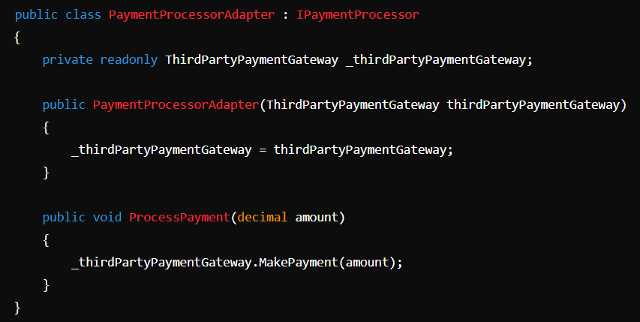
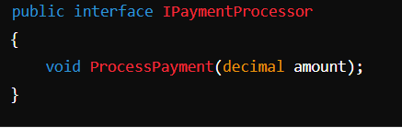
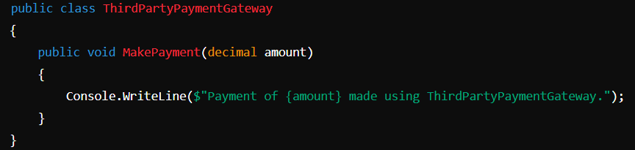
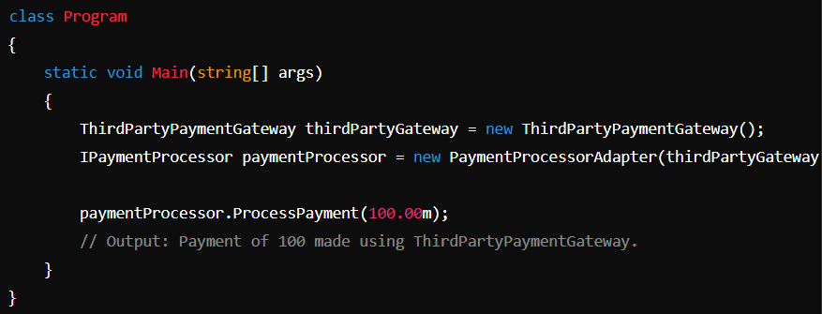
How Does It Work?
The Adapter Pattern is a structural design pattern that allows objects with incompatible interfaces to work together. It acts as a bridge between two different interfaces, enabling classes that could not otherwise interact due to incompatible interfaces to collaborate.
Benefits of the Adapter Pattern
It promotes code reuse, decouples systems, and makes the integration of third-party or legacy code easier.
Adapter

Slide 10
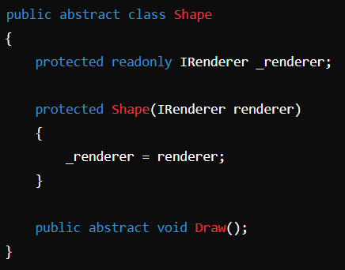
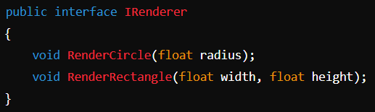
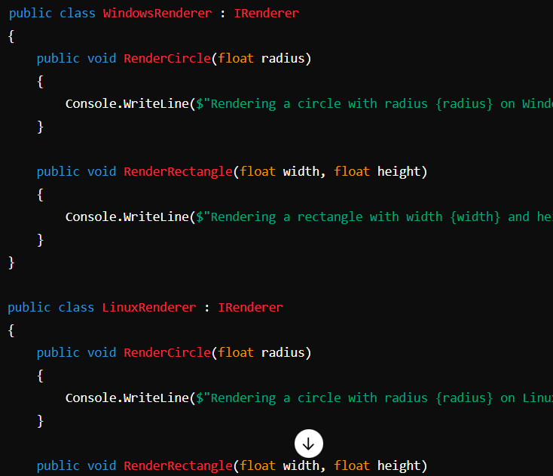
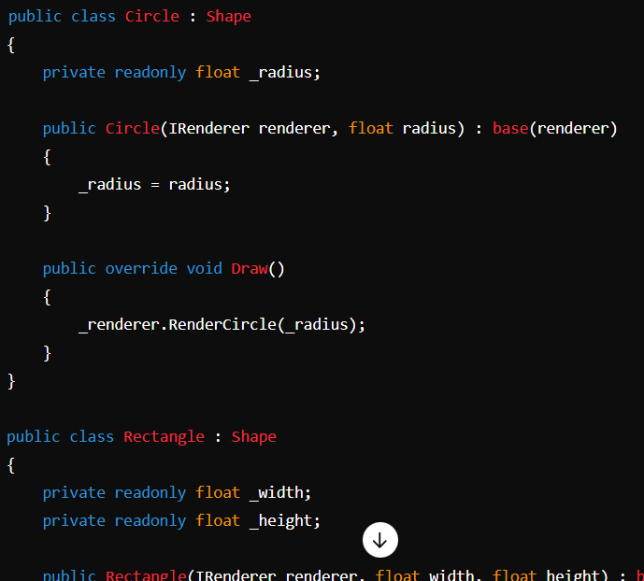
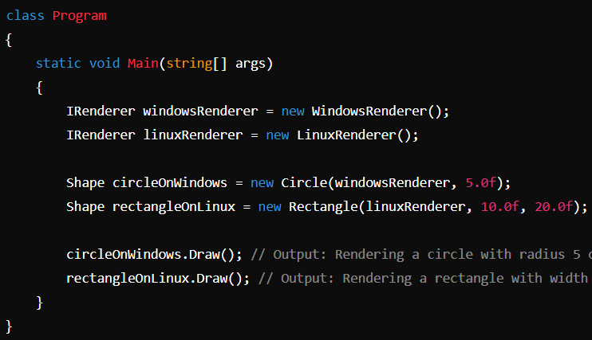
Benefits of the Bridge Pattern
Decoupling: Separates abstraction from implementation, making them easier to change and extend independently.
Flexibility: Allows both the abstraction and implementation to evolve without modifying each other.
Scalability: Facilitates the addition of new abstractions and implementations without creating a large number of classes.
How Does It Work?
The Bridge Pattern is a structural design pattern that separates an abstraction from its implementation, allowing the two to evolve independently. It is used to decouple an abstraction from its implementation so that changes to one can be made without affecting the other.
Bridge

Slide 11
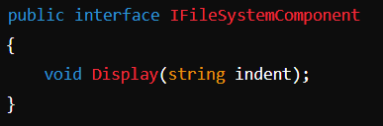
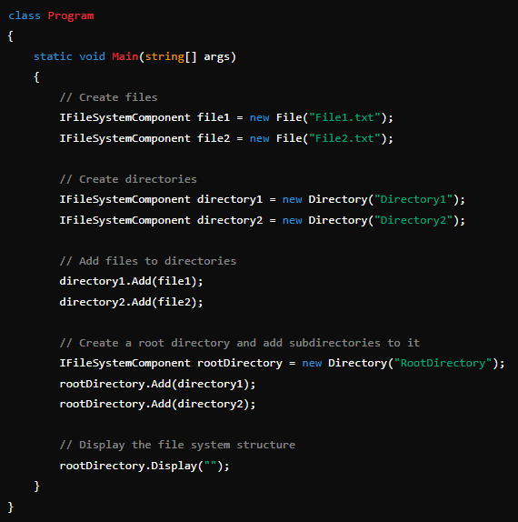
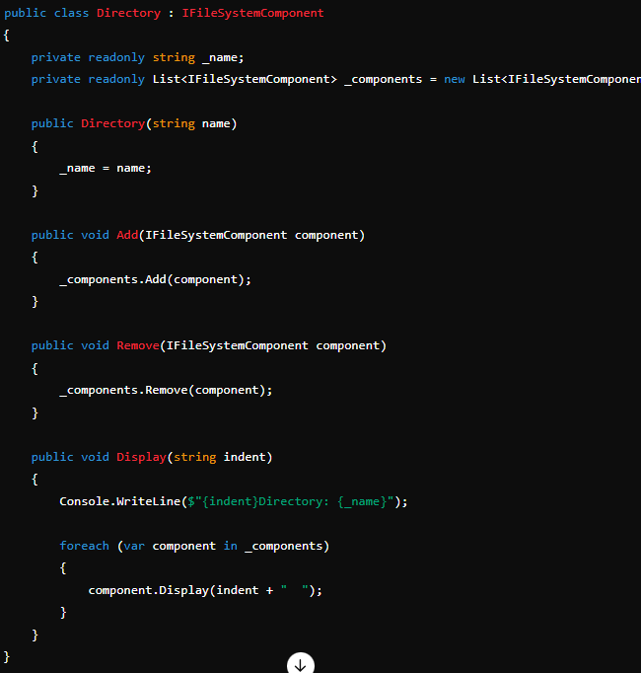
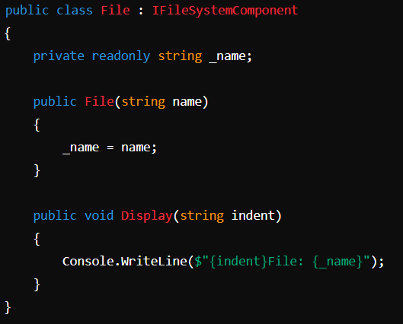
Benefits of the Composite Pattern
Simplicity: Clients can treat both individual objects and compositions of objects uniformly, simplifying the client code.
Flexibility: New types of components (both leaf and composite) can be added without changing existing code.
Ease of Maintenance: Modifications to the tree structure are localized to the composite objects, making the system easier to maintain.
How Does It Work?
The Composite Pattern is a structural design pattern used to allow clients to treat individual objects and compositions of objects uniformly. It is particularly useful when dealing with tree-like structures, where you want to treat both individual objects and groups of objects in the same way.
Composite

Slide 12
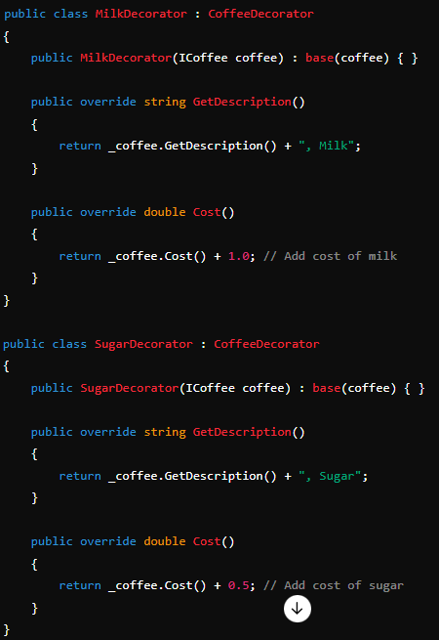
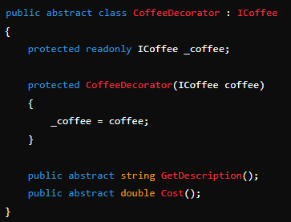
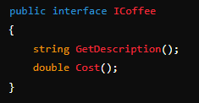
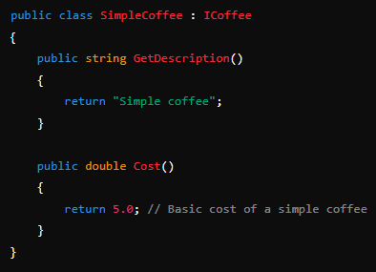
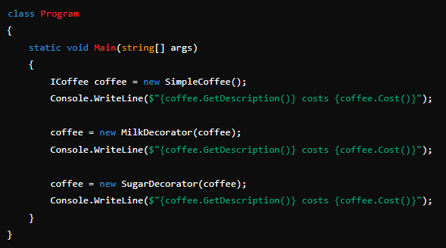
Benefits of the Decorator Pattern
Flexibility: Allows adding new behavior dynamically without modifying existing code.
Single Responsibility Principle: Each decorator handles a single responsibility, making code more maintainable.
Reusability: Decorators can be combined in various ways to achieve different functionalities.
How Does It Work?
The Decorator Pattern is a structural design pattern used to dynamically add or augment functionalities of objects at runtime without altering their structure. It allows you to extend the behavior of objects in a flexible and reusable way by wrapping them with additional responsibilities.
Decorator

Slide 13
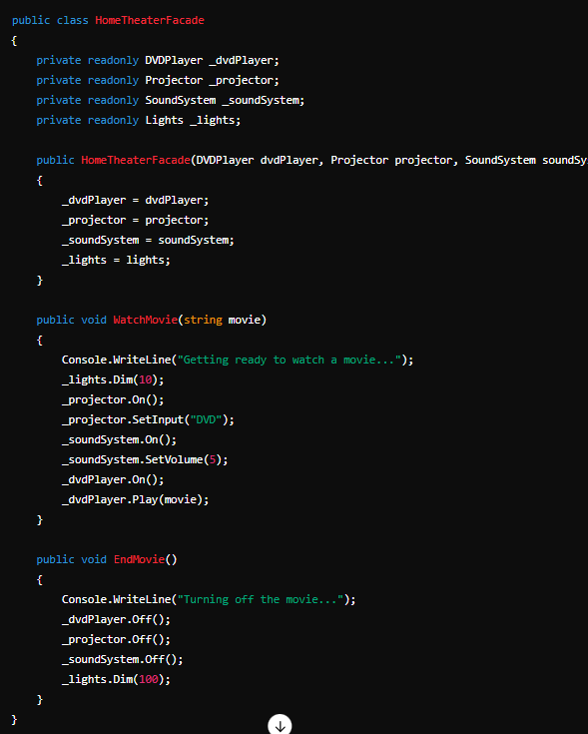
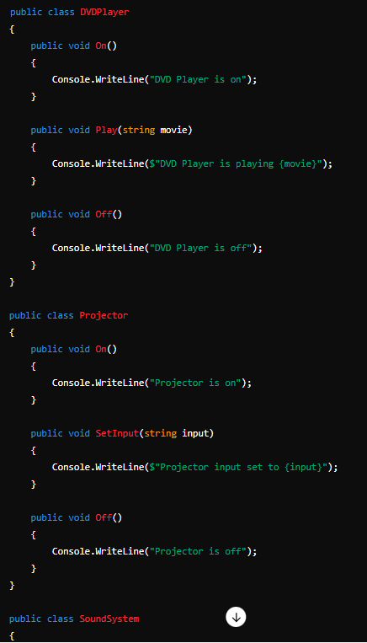
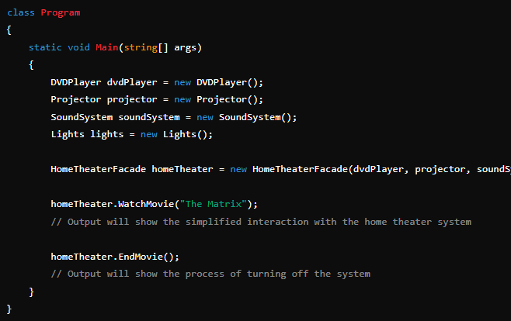
Benefits of the Facade Pattern
Simplicity: Provides a simplified and unified interface to a complex subsystem.
Encapsulation: Hides the complexities of the subsystem from the client.
Reduced Coupling: Decouples the client from the subsystem, making the system easier to maintain and modify.
How Does It Work?
The Facade Pattern is a structural design pattern that provides a simplified and unified interface to a set of interfaces in a subsystem, making it easier for clients to interact with that subsystem. It hides the complexities of the subsystem and provides a higher-level interface that is easier to use.
Facade

Slide 14
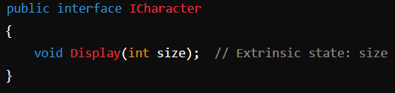
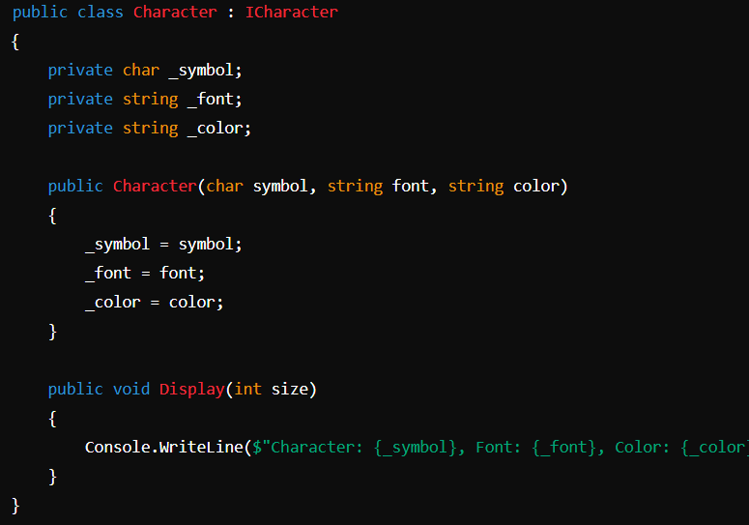
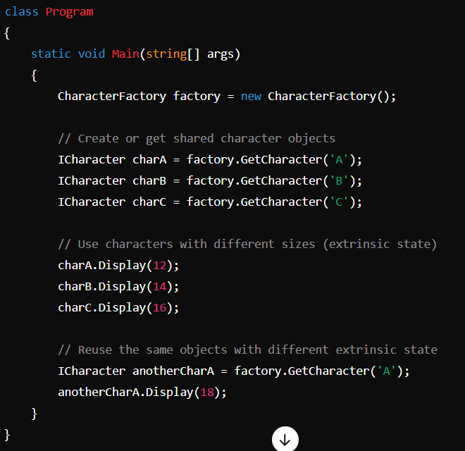
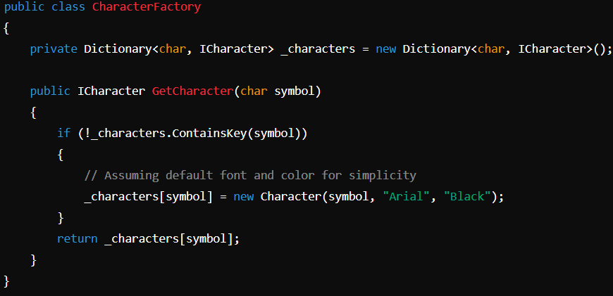
How Does It Work?
The Flyweight Pattern is a structural design pattern that aims to minimize memory usage by sharing as much data as possible between similar objects. It is particularly useful when an application has a large number of objects that share common data. Instead of storing the same data repeatedly for each object, the Flyweight Pattern allows you to store it once and share it among multiple objects.
Benefits of the Flyweight Pattern
Reduced Memory Usage: The pattern minimizes memory usage by sharing common data among multiple objects.
Improved Performance: By reducing the number of objects created, the pattern can improve performance, especially in memory-constrained environments.
Separation of Concerns: It clearly separates the shared (intrinsic) state from the non-shared (extrinsic) state, leading to a more organized and maintainable codebase.
Flyweight

Slide 15

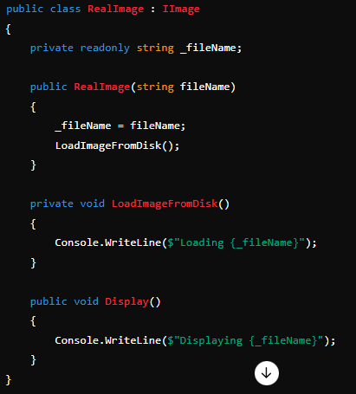
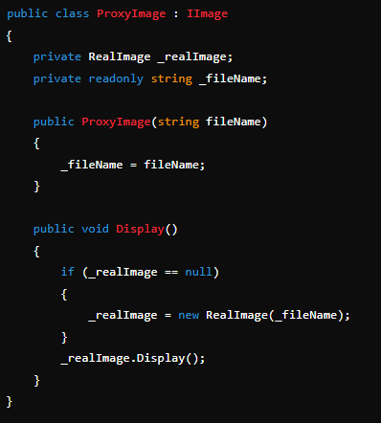
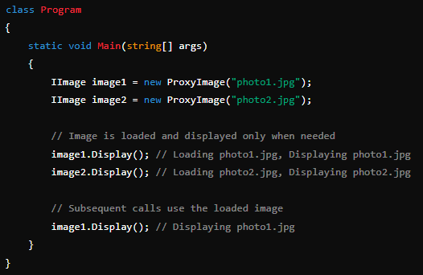
How Does It Work?
The Proxy Pattern is a structural design pattern that provides a surrogate or placeholder for another object to control access to it. It allows you to create an interface that represents the real object but can add additional functionality such as access control, lazy initialization, logging, or other cross-cutting concerns.
Benefits of the Proxy Pattern
Control Access: Allows control over access to the RealSubject, such as implementing lazy initialization or access control.
Enhanced Functionality: Provides a way to add additional functionality (like logging or caching) without modifying the RealSubject.
Flexibility: Decouples the client from the RealSubject, providing more flexibility in managing object interactions.
Proxy

Slide 16
Behavioral Patterns
Chain of Responsibility: Passes requests along a chain of handlers.
Command: Encapsulates a request as an object.
Interpreter: Defines a grammar and an interpreter for it.
Iterator: Provides a way to traverse a collection.
Mediator: Centralizes communication between objects.
Memento: Captures and restores an object's internal state.
Observer: Implements a one-to-many dependency for state changes.
State: Alters behavior when an object's state changes.
Strategy: Encapsulates interchangeable algorithms.
Template Method: Defines an algorithm's skeleton, allowing subclasses to customize parts.
Visitor: Adds operations to a structure without modifying its elements.

Slide 17
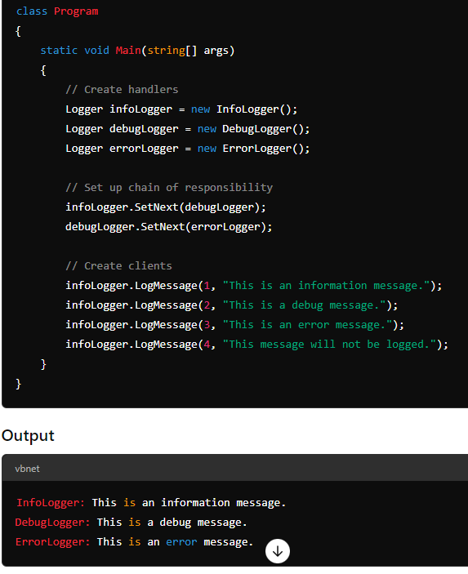
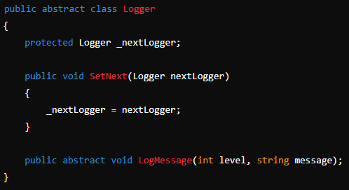
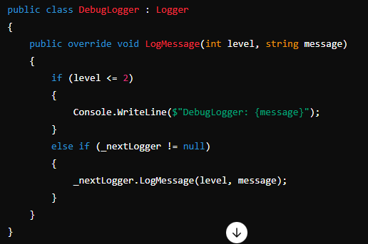
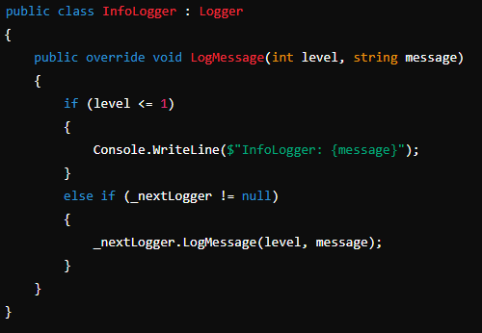
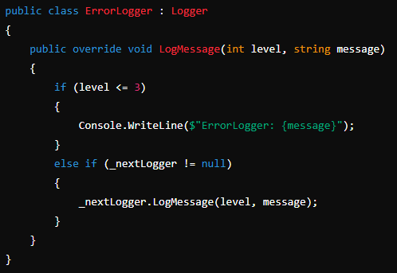
How Does It Work?
The Chain of Responsibility Pattern is a behavioral design pattern that allows an object to pass a request along a chain of potential handlers until one of them handles the request. It decouples the sender of a request from the receiver by allowing multiple objects to process the request, each handling only a portion of the request or passing it along to the next handler in the chain.
Benefits of the Chain of Responsibility Pattern
Flexibility: Allows dynamic modification of the chain and order of handlers without changing the client code.
Reduced Coupling: Decouples the sender from the receivers, allowing handlers to be added or removed independently.
Simplified Code: Simplifies the addition of new handlers or changing the handling logic without altering existing code.
Chain of responsibility

Slide 18
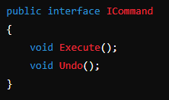
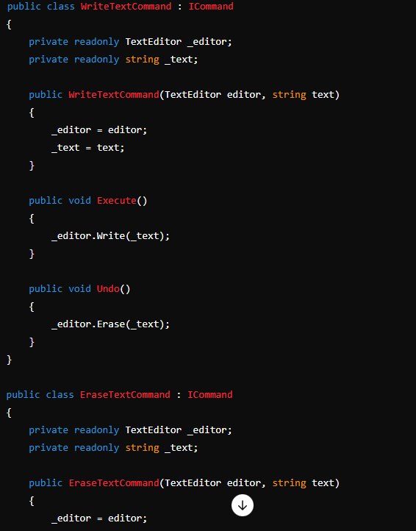



How Does It Work?
The Command Pattern is a behavioral design pattern in object-oriented programming. It is used to encapsulate a request as an object, thereby allowing for parameterization of clients with different requests, queuing of requests, and logging of the requests. The pattern also provides support for undoable operations.
Benefits of Command Pattern
Decoupling: The command pattern decouples the objects that issue a request from the objects that actually process the request. This separation allows changes to either side without affecting the other.
Extensibility: New commands can be added without modifying existing code, enhancing flexibility and maintainability.
Undo/Redo: Since commands can be stored, they can be executed, undone, or redone later, making the pattern useful for implementing undo/redo functionality.
Logging and Queuing: Commands can be queued, logged, and executed in order, providing more control over complex operations.
Command

Slide 19




Benefits of Interpreter Pattern
Simple Grammars: It's useful for implementing simple grammars where the syntax is not too complex.
Extensibility: New rules or expressions can be added easily by creating new terminal or non-terminal expression classes.
Readability: The structure closely resembles the grammar of the language, making it easier to understand and maintain.
How Does It Work?
The Interpreter Pattern is used to define a grammar and interpret sentences in a language by creating a tree structure where each node is an expression.
Interpreter

Slide 20





How Does It Work?
The Iterator Pattern is a behavioral design pattern that provides a way to access the elements of a collection (such as a list, array, or tree) sequentially without exposing the underlying structure of the collection. It allows clients to traverse a collection item by item in a uniform way, regardless of the collection's type or how it is implemented.
Benefits of Iterator Pattern
Decoupling: The Iterator Pattern separates the traversal logic from the collection itself, allowing you to change the way you traverse a collection without altering the collection’s implementation.
Uniform Access: It provides a standard way to traverse different types of collections, so you can use the same code to iterate over a list, a tree, or another structure.
Flexibility: You can implement different types of iterators (e.g., forward, reverse, or even custom traversal) for the same collection.
Commonly implement Next, HasNext and CurrentItem.
Iterator

Slide 21




How Does It Work?
The Mediator Pattern is a behavioral design pattern that facilitates communication between objects by introducing a mediator object. Instead of objects directly interacting with each other, they interact through the mediator, which centralizes and manages communication.
Benefits of Mediator Pattern?
Reduces Dependencies: By centralizing communication in the mediator, you reduce the dependencies between colleague objects, leading to more modular and maintainable code.
Simplifies Object Collaboration: Complex communications and dependencies among objects can be simplified by encapsulating the logic in the mediator.
Flexibility: The mediator can be changed or extended to alter how objects interact without modifying the colleagues.
Mediator

Slide 22




How Does It Work?
The Memento Pattern is a behavioral design pattern that allows an object to capture its internal state and restore it later without exposing its internal structure. This pattern is useful for implementing undo/redo functionality or saving and restoring the state of an object.
Benefits of Memento Pattern
Encapsulation: The memento pattern encapsulates the internal state of an object without exposing its implementation details.
Undo/Redo Functionality: It provides a way to revert an object to a previous state, making it ideal for implementing undo and redo functionalities.
State Restoration: It allows saving and restoring object states, which can be useful in scenarios like checkpoints in a game or saving the progress in an editor.
Memento

Slide 23





How Does It Work?
The Observer Pattern is a behavioral design pattern used to define a one-to-many dependency between objects. When the state of one object (the subject) changes, all dependent objects (observers) are notified and updated automatically. This pattern is commonly used in scenarios where changes to one object need to be reflected in other objects without tightly coupling them.
Benefits of Observer Pattern
Decoupling: It allows the subject and observers to be loosely coupled. The subject does not need to know the details of the observers, only that they implement the observer interface.
Dynamic Relationships: Observers can be added or removed dynamically at runtime, providing flexibility in how changes are propagated.
Automatic Notification: Changes in the subject automatically propagate to all registered observers, ensuring that all dependent objects remain up-to-date.
Observer

Slide 24




How Does It Work?
The State Pattern is a behavioral design pattern that allows an object to alter its behavior when its internal state changes. This pattern helps an object appear to change its class by encapsulating the state-specific behaviors in separate state classes.
Benefits of State Pattern
Simplifies State Management: Encapsulates state-specific behavior and transitions in separate classes, making it easier to manage and extend.
Avoids Large Conditional Statements: Eliminates complex conditional statements that handle state-specific behavior by delegating the behavior to state objects.
Flexible State Transitions: Makes it easier to manage and change state transitions without modifying the state-specific behavior.
State

Slide 25




How Does It Work?
The Strategy Pattern is a behavioral design pattern that allows an object to change its behavior at runtime by encapsulating a family of algorithms or strategies. Instead of having a single method with complex conditional logic to handle various behaviors, the Strategy Pattern defines a set of interchangeable algorithms and lets the client choose which one to use.
Benefits of Strategy Pattern
Flexibility: It allows clients to choose or switch strategies dynamically at runtime.
Open/Closed Principle: You can add new strategies without modifying existing code, adhering to the open/closed principle.
Encapsulation: Each strategy encapsulates a specific algorithm, making it easier to manage and maintain different behaviors.
Strategy

Slide 26



How Does It Work?
The Template Method Pattern is a behavioral design pattern that defines the skeleton of an algorithm in a base class but lets subclasses redefine certain steps of the algorithm without changing its structure. This pattern allows you to implement invariant parts of an algorithm in a base class while allowing subclasses to implement the steps that can vary.
Benefits of Template Method Pattern
Code Reuse: Common parts of an algorithm can be implemented in a base class, allowing reuse in multiple subclasses.
Control Over Algorithm Structure: The base class defines the algorithm’s skeleton, ensuring that the overall structure remains consistent while allowing flexibility in specific steps.
Encapsulation: Encapsulates the invariant parts of the algorithm in the base class, promoting a clear separation between stable and varying parts of the algorithm.
Template Method

Slide 27





How Does It Work?
The Visitor Pattern is a behavioral design pattern that allows you to separate algorithms from the objects on which they operate. This pattern lets you define new operations on objects without changing the objects themselves. It is particularly useful when you need to perform operations on a set of objects that belong to different classes but share a common interface.
Why Use the Visitor Pattern?
Separation of Concerns: It separates the algorithm from the objects on which it operates, allowing you to add new operations without modifying the existing objects.
Flexibility: You can add new operations without changing the classes of the elements, making it easier to extend functionality.
Single Responsibility Principle: Helps in adhering to the single responsibility principle by separating data (element classes) from operations (visitor classes).
Visitor

Slide 28
Two-Phase Commit (2PC)
Description: A protocol used to ensure all participants in a distributed transaction either commit or roll back the transaction, ensuring consistency across the system.
How It Works:
Prepare Phase: The coordinator sends a prepare request to all participants, asking if they can commit the transaction.
Commit Phase: If all participants agree to commit, the coordinator sends a commit command. If any participant votes to abort, the coordinator sends a rollback command.
Use Case: Distributed database transactions where multiple systems need to agree on committing or rolling back.

Slide 29
Saga Pattern
Description: A pattern for managing long-running transactions that are broken into a series of smaller, independent operations (steps), each with a compensating action in case of failure.
How It Works:
Execute a series of operations in a sequence.
If any operation fails, execute the compensating actions in reverse order to undo the effects of previous operations.
Use Case: Distributed transactions in microservices architectures, where using traditional ACID transactions is impractical.

Slide 30
Event Sourcing
Description: A pattern where changes to the application state are stored as a sequence of events, rather than just the final state.
How It Works:
Each change to the state is captured as an event and stored in an event log.
The current state is reconstructed by replaying the events from the log.
Use Case: Systems that require a full audit trail of all changes or where the ability to replay history is crucial, such as in financial applications.

Slide 31
Outbox Pattern
Description: Ensures that changes in a transaction are safely recorded and reliably communicated to other systems by using an outbox table within the same database transaction.
How It Works:
Within a single transaction, update the business data and record the event in an outbox table.
A separate process (e.g., a message dispatcher) reads the outbox table and sends the events to a message broker or external system.
Use Case: Ensuring reliable message delivery in event-driven architectures, particularly when integrating with external systems.

Slide 32
Compensating Transaction
Description: A technique where a "compensating" or "undo" transaction is executed to reverse the effects of a previous transaction that failed.
How It Works:
Perform the original transaction.
If the transaction fails, execute a compensating transaction that undoes the effects of the original one.
Use Case: Systems where operations cannot be rolled back automatically and must be undone manually, such as in booking systems.

Slide 33
Retry Pattern
Description: A pattern that handles transient failures by automatically retrying an operation until it succeeds or a maximum number of retries is reached.
How It Works:
Attempt to execute an operation.
If the operation fails due to a transient error, retry it after a short delay.
Continue retrying until the operation succeeds or the retry limit is reached.
Use Case: Handling temporary network issues, timeouts, or service unavailability in distributed systems.

Slide 34
Circuit Breaker Pattern
Description: A pattern that prevents an application from repeatedly attempting an operation that is likely to fail, by short-circuiting the operation after a certain number of failures.
How It Works:
Monitor the success/failure rate of an operation.
If failures exceed a threshold, "open" the circuit to prevent further attempts.
After a cooldown period, "half-open" the circuit to test if the operation can succeed.
If the operation succeeds, "close" the circuit; otherwise, keep it open.
Use Case: Preventing cascading failures in distributed systems by stopping the flow of requests to a failing service.

Slide 35
Unit of Work Pattern
Description: A pattern that manages a group of operations as a single unit, ensuring that either all operations succeed or none do.
How It Works:
Track changes to multiple objects during a transaction.
At the end of the transaction, apply all changes together or discard them if any part fails.
Use Case: ORM frameworks like Entity Framework use this pattern to manage database transactions.

Slide 36
Transaction Script Pattern
Description: A simple pattern where business logic is implemented directly within a transaction, usually in a procedural or script-like manner.
How It Works:
Encapsulate the transaction logic in a single script or method.
Execute the script as a single unit of work.
Use Case: Simple applications where business logic and transaction management can be easily handled within a single script.

Slide 37
Idempotent Receiver
Description: A pattern that ensures that the receiver of a message or request can handle duplicate messages or requests without unintended side effects.
How It Works:
Generate an idempotency key for each request or message.
Before processing, check if the key has already been handled.
If it has, skip processing; otherwise, process the request and record the key.
Use Case: Ensuring safe processing of messages in distributed systems, where duplicates might occur due to retries or network issues.

